Slide 1
Bantuan Hidup Dasar

Slide 2
Saat Jantung Berhenti Berdenyut
Kematian klinis : henti nafas dan henti jantung →RJP segera
4-6 menit → sel otak mulai mengalami kematian, (8-10 menit) tanpa denyut nadi → kerusakan irreversible otak.

Slide 3
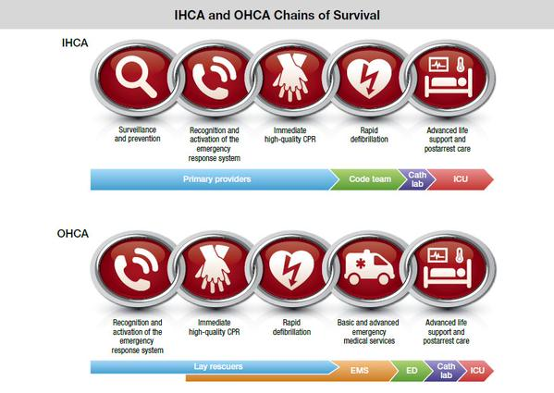
THE CHAIN OF SURVIVAL

Slide 4
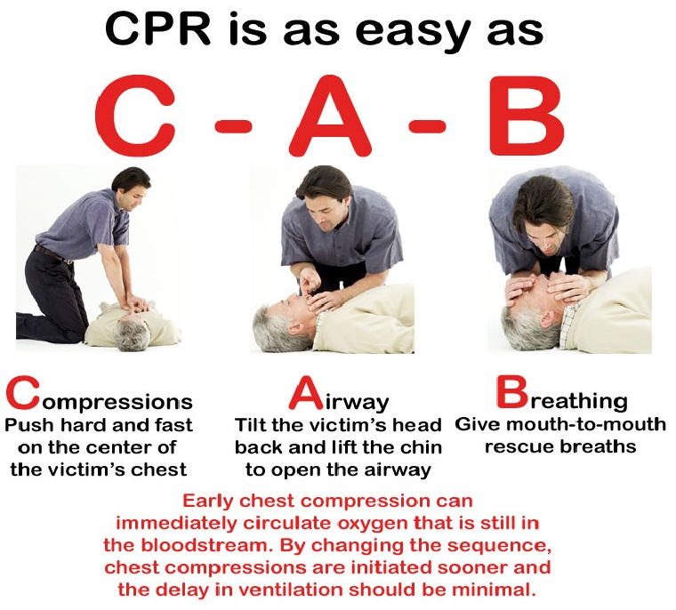
D
TIGA AMAN (PENOLONG, LINGKUNGAN & PASIEN)
R
CEK RESPON : A – V – P - U
ADA / TDK REAKSI KORBAN
CALL FOR HELP
3
C
CEK NADI CAROTIS simultan CEK PERNAFASAN / NAFAS TERHENTI
A
B
Notes:
What will the audience be able to do after this training is complete? Briefly describe each objective how the audience will benefit from this presentation.

Slide 5
Hight Quality CPR
Rate of at least 100-120 chest compressions per minute
Compression depth at least (5 - 6 cm)
Allow complete chest recoil after each compression
Avoid excessive ventilation /
Hiperventilation x

Slide 6
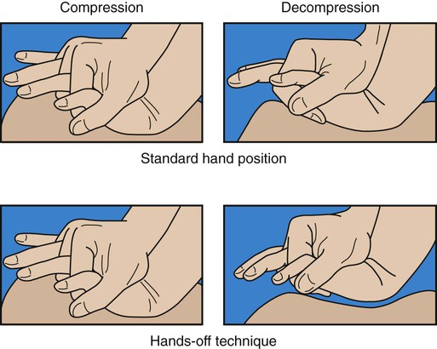

Slide 7
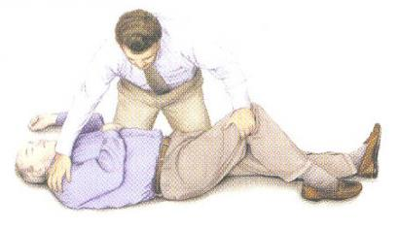
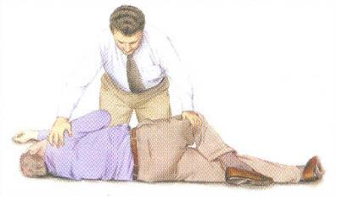
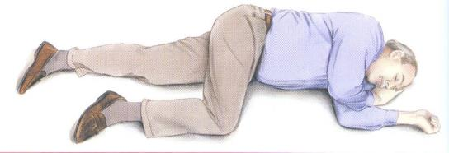
POSISI MIRING MANTAP / RECOVERY POSITION
Pada pasien tdk sadar, nafas spontan, dan teraba sirkulasi spontan, maka pertolongan ditujukan utk mempertahankan jalan nafas bebas dari sumbatan lidah dan mengurangi terjadinya aspirasi isi lambung.

